Slide 1
Winning Space Race with Data Science
CHLOE TENG 28 August 2026

Slide 2
Outline
01
02
03
Executive Summary
Introduction
Methodology
04
05
06
Results
Conclusion
Appendix

Slide 3
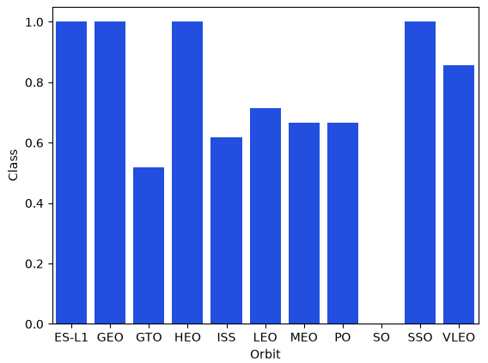
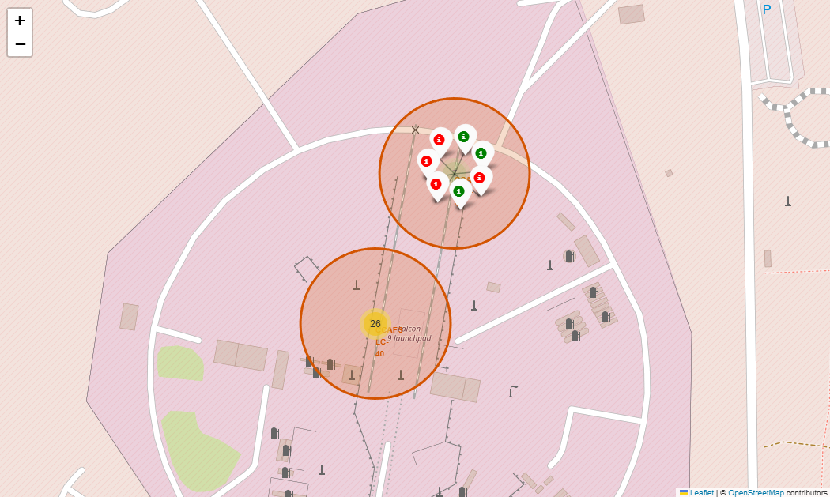
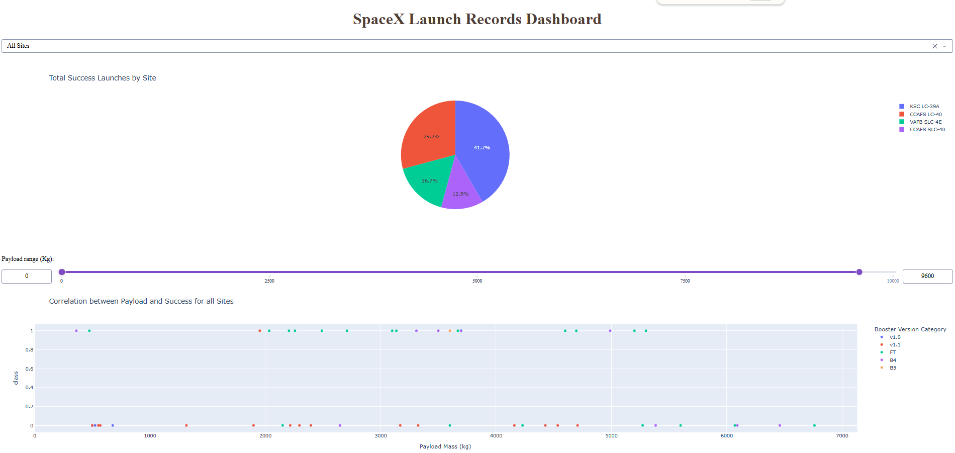
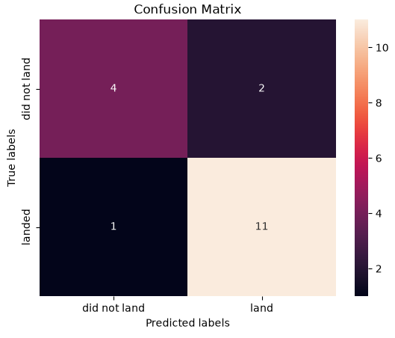
Executive Summary
Summary of Methodologies
Summary of Results
This project follows these steps:
This project produced the following outputs
and visualisations:
Data Collection
Data Wrangling
Exploratory Data Analysis (EDA)
Interactive Visual Analytics
Predictive Analysis (Classification)
Exploratory Data Analysis (EDA) Results
Geospatial Analytics (Folium Interactive Map)
Interactive Dashboard (Plotly Dash)
Predictive Analysis of Classification Models

Slide 4
Introduction
SpaceX has significantly reduced the cost of rocket launches by developing reusable Falcon 9 rockets. The company advertises Falcon 9 launches at approximately $62 million, while traditional launch providers may charge over $165 million per launch.
A major factor behind this cost advantage is SpaceX's ability to recover and reuse the Falcon 9 first stage. However, the success of first-stage landing depends on various mission factors, such as launch site, payload, orbit type, and booster characteristics.
In this project, we analyse historical Falcon 9 launch data and apply machine learning techniques to predict whether the first stage will successfully land. The results can help estimate launch costs and provide insights for companies seeking to compete in the commercial space launch market.
Can we predict whether the Falcon 9 first stage will successfully land based on historical launch data?
Which factors have the greatest impact on first-stage landing success?
What launch conditions or configurations provide the highest probability of a successful landing?
Can the prediction model help estimate launch costs and support decision-making for companies competing with SpaceX?

Slide 5
Methodology Summary
Data Collection
Collected Falcon 9 launch data using the SpaceX REST API
Performed web scraping from Wikipedia Falcon 9 launch records to obtain historical launch information
Data Wrangling and Data Processing
Cleaned and transformed the collected data using Pandas
Handled missing values and formatted variables for analysis
Created the landing outcome class label: 1 = Successful first-stage landing, 0 = Unsuccessful first-stage landing
Prepared features including launch site, payload mass, orbit type, and booster information
Exploratory Data Analysis (EDA)
Used SQL queries to filter, aggregate, and analyze the SpaceX launch dataset
Applied Pandas, Matplotlib, and Seaborn visualization techniques to explore relationships between launch factors and landing success

Slide 6
Methodology Summary
4. Interactive Visual Analytics
Used Folium for geospatial analysis of launch sites and success patterns
Developed an interactive Plotly Dash dashboard to analyze launch performance based on launch site and payload characteristics
5. Predictive Analysis and Model Evaluation
Applied classification algorithms using Scikit-Learn
Standardized features and split data into training and testing datasets
Trained multiple classification models: Logistic Regression, Support Vector Machine (SVM), Decision Tree, and K-Nearest Neighbor (KNN)
Used GridSearchCV for hyperparameter tuning
Evaluated models using: Accuracy score and Confusion matrix

Slide 7
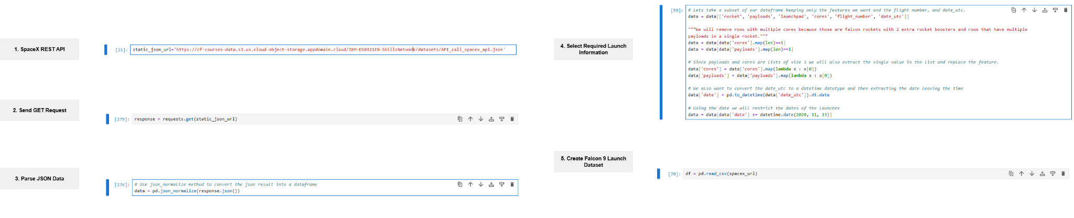
Data Collection - SpaceX REST API
Objective: Retrieve structured Falcon 9 launch data from the SpaceX REST API, including rocket, payload information, launch site, core information, flight number, and launch date.
Flowchart (See Slide 54 Appendix for full view):
GitHub URL of My SpaceX REST API Notebook

Slide 8
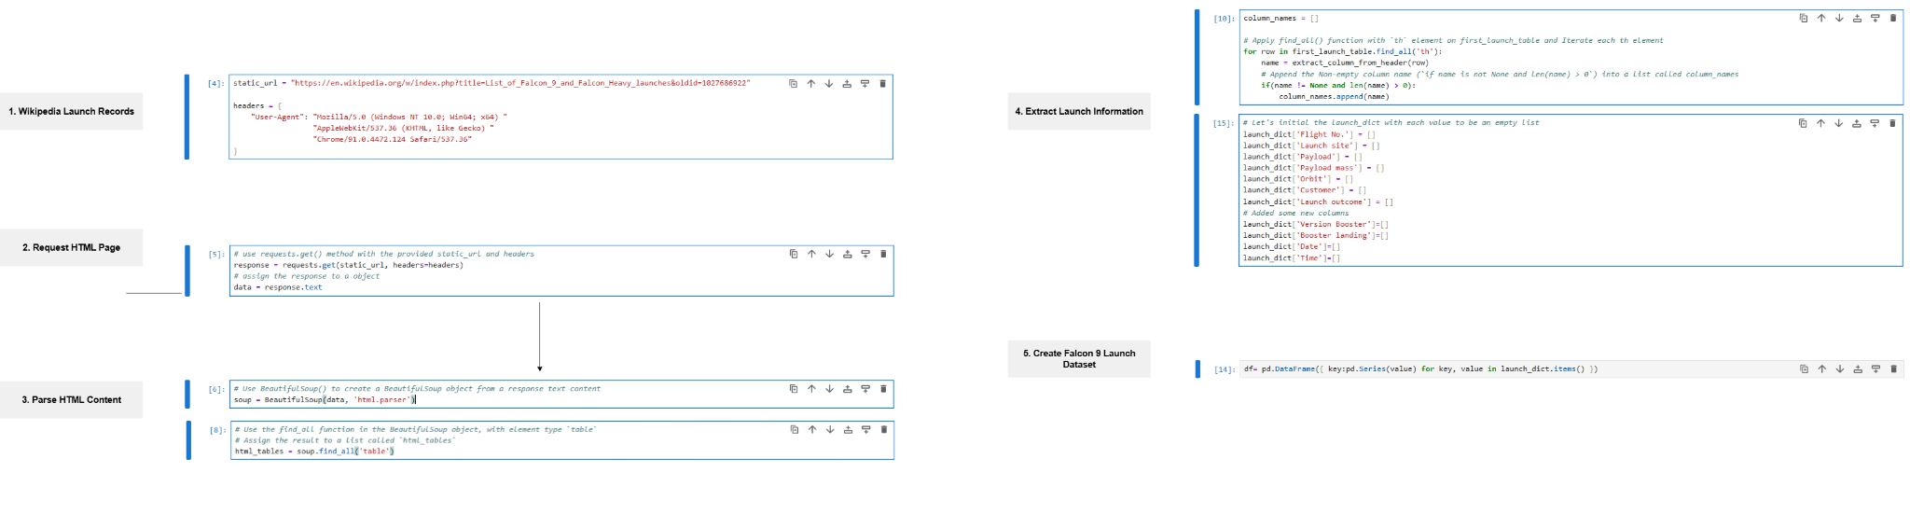
Data Collection - Web Scraping
Objective: Collect historical Falcon 9 launch records by scraping launch tables from a Wikipedia page titled "List of Falcon 9 and Falcon Heavy launches".
Flowchart (See Slide 54 Appendix for full view):
GitHub URL of My Web Scraping Notebook

Slide 9
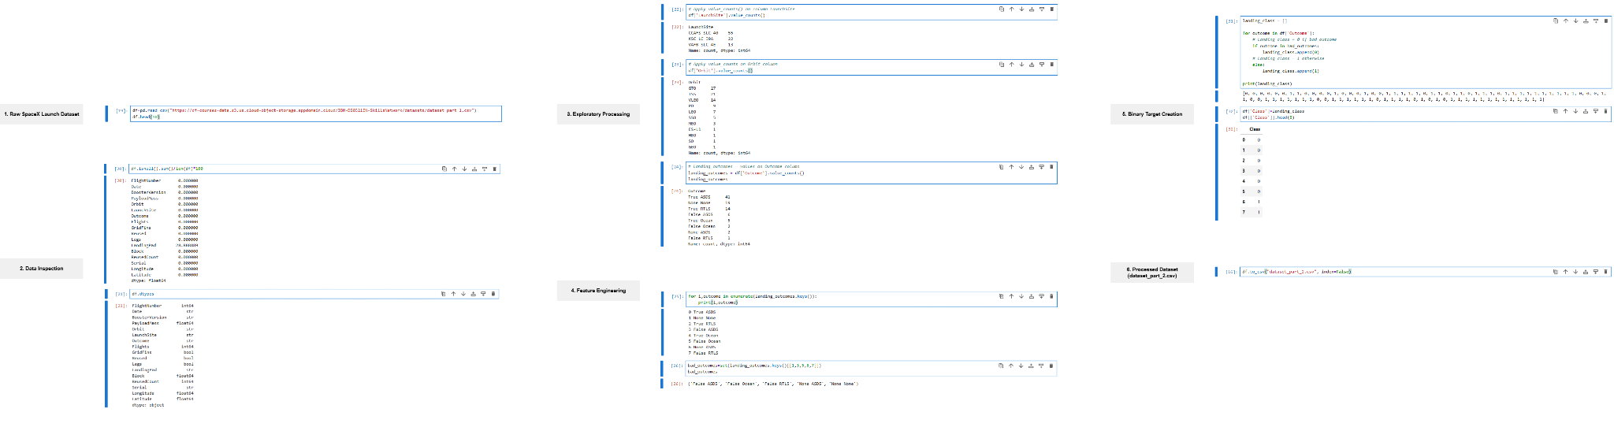
Data Wrangling
Flowchart (See Slide 54 Appendix for full view):
GitHub URL of My Data Wrangling Notebook

Slide 10



Exploratory Data Analysis (EDA) - Visualization
Scatter Plots
Bar Charts
Line Charts
01
02
03
Used to visualize relationships between launch characteristics and landing success (Class = 0 for unsuccessful landing; Class = 1 for successful landing).
Flight Number vs Launch Site
Payload Mass vs Launch Site
Flight Number vs Orbit Type
Payload Mass vs Orbit Type
Used to compare landing success rates across categorical variables,
Success Rate vs Orbit Type
Used to analyse changes and trends in landing success over time.
Year vs Landing Success Rate
GitHub URL of My EDA Visualization Notebook

Slide 11
Exploratory Data Analysis (EDA) - SQL
To extract key insights about the SpaceX launch dataset, multiple SQL queries were performed:
Display the names of the unique launch sites in the space mission
Display 5 records where launch sites begin with the string 'CCA'
Display the total payload mass carried by boosters launched by NASA (CRS)
Display average payload mass carried by booster version F9 v1.1
List the date when the first successful landing outcome in ground pad was achieved
List the names of the boosters which have success in drone ship and have payload mass greater than 4000 but less than 6000
List the total number of successful and failure mission outcomes
List the names of the boosters which have carried the maximum payload mass
List the failed landing outcomes in drone ship, their booster versions, and launch site names in 2015
Rank the count of landing outcomes such as Failure (drone ship) or Success (ground pad) between the date 2010-06-04 and 2017-03-20, in descending order
GitHub URL of My EDA SQL Notebook

Slide 12
Geospatial Analysis - Folium Interactive Map
The following steps were taken to visualize the launch data on the map:
Mark all launch sites
Initialize the interactive map using folium.Map as the base map for displaying SpaceX launch locations
Add folium.Circle objects to highlight the geographic positions of launch sites
Add folium.map.Marker objects with DivIcon labels to display launch site names
Add folium.Popup objects to display launch site names when users click on the locations
Mark successful and failed launches for each site
Add MarkerCluster objects to group multiple launches at the same location and improve map readability
Add folium,map.Marker objects with folium.Icon colours: green for successful landings (Class = 1) and red for unsuccessful landings (Class = 0) to visually distinguish landing outcomes
Visualize distances between launch sites and nearby locations
Add folium.Marker objects with DivIcon labels to display calculated distances between launch sites and nearby locations
Add folium.PolyLine objects to draw connections between launch sites and nearby locations
GitHub URL of My Interactive Map (Folium) Notebook

Slide 13
Interactive Dashboard - Plotly Dash
The following plots and interactive components were added to the dashboard to analyze SpaceX launch records:
Launch Site Selection Added a dcc.Dropdown component to allow users to select a specific launch site or view all sites. This enables users to dynamically filter dashboard results based on launch site selection.
Success Launch Distribution Added a plotly.express.pie pie chart to display launch success distribution across different launch sites. This provides a visual comparison of launch success performance between sites.
Payload Range Filtering Added a dcc.RangeSlider component to filter launches based on payload mass range. This allows users to explore launch outcomes for different payload sizes.
GitHub URL of My Interactive Dashboard (Plotly Dash) Notebook

Slide 14
Interactive Dashboard - Plotly Dash
GitHub URL of My Interactive Dashboard (Plotly Dash) Notebook
4. Payload Mass vs Launch Success Added a plotly.express.scatter plot to visualize the relationship between payload mass and landing success (Class). This helps to identify patterns between payload mass, launch success, and booster version categories.
5. Interactive Dashboard Updates
Added Dash callback functions to update charts based on dropdown and slider inputs. This allows users to dynamically explore different launch sites and payload ranges without generating separate charts.

Slide 15
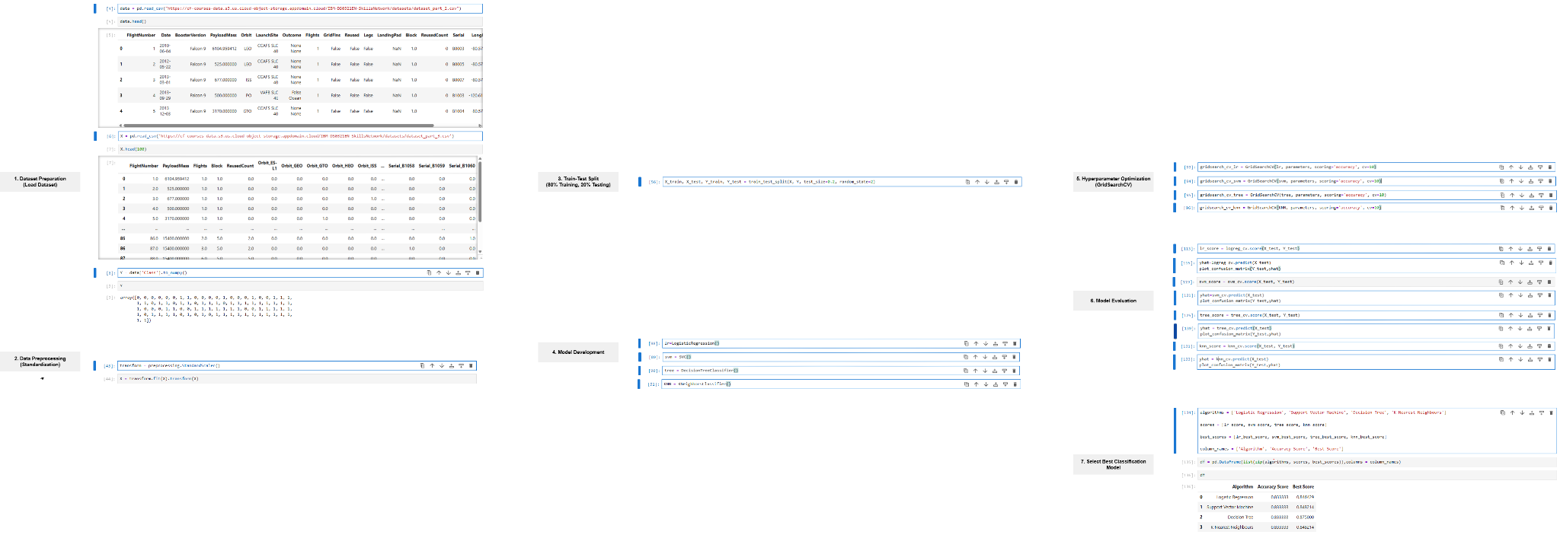
Predictive Analysis - Classification
The following steps were performed to develop, optimize, evaluate, and select the best performing classification model:
Flowchart (See Slide 54 Appendix for full view):
GitHub URL of My Predictive Analysis (Classification) Notebook

Slide 16
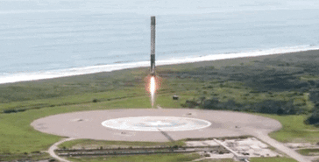
Results
01
Exploratory Data Analysis (EDA)
02
Interactive Analytics
03
Predictive Analysis - Classification

Slide 17
Results
01
EDA with Visualization

Slide 18
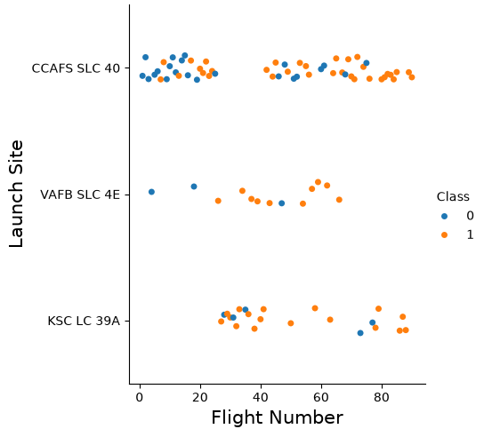
Flight Number vs Launch Site
The scatter plot of Flight Number vs Launch Site shows that:
Higher flight numbers have more successful landing outcomes across different launch sites Later Falcon 9 flights contain more successful landings (Class = 1), suggesting improved landing performance over time.
CCAFS SLC 40 has the largest number of launches across the dataset This site has both early and later missions, with successful and unsuccessful landing outcomes observed across different flight numbers.

Slide 19
Flight Number vs Launch Site
3. VAFB SLC 4E has successful and unsuccessful landing outcomes across different flight numbers Early flights have more unsuccessful landing outcomes, while later missions mostly have successful landing outcomes.
4. KSC LC 39A mainly has later flight numbers with mostly successful landing outcomes
Most launches from this site occurred at higher flight numbers and have a higher proportion of successful landings.
5. Launch site alone does not show a clear relationship with landing outcomes
Within each launch site, higher flight numbers generally have more successful landing outcomes, suggesting improved landing performance over time.

Slide 20
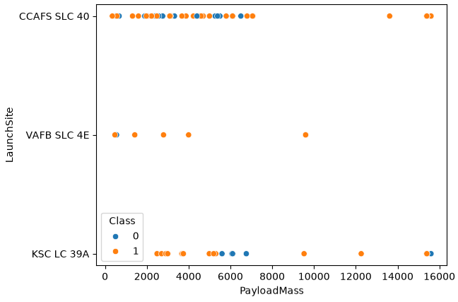
Payload Mass vs Launch Site
The scatter plot of Payload Mass vs Launch Site shows that:
CCAFS SLC 40 has the largest number of launches across a wide range of payload masses Most launches from this site have payload masses below approximately 7,000 kg, with both successful and unsuccessful landing outcomes observed.
Higher payload masses do not show a clear relationship with landing success Successful and unsuccessful landing outcomes are observed across different payload ranges, suggesting payload mass alone does not show a clear relationship with landing outcomes.

Slide 21
Payload Mass vs Launch Site
3. KSC LC 39A has mainly higher payload mass missions Most launches from this site have payload masses above approximately 2,500 kg, with the majority having successful landing outcomes.
4. VAFB SLC 4E has fewer launches, with successful and unsuccessful landing outcomes observed across different payload masses
The limited number of observations makes it difficult to identify A strong payload-related trend. Overall, payload mass alone does not show a clear relationship with landing outcomes.

Slide 22
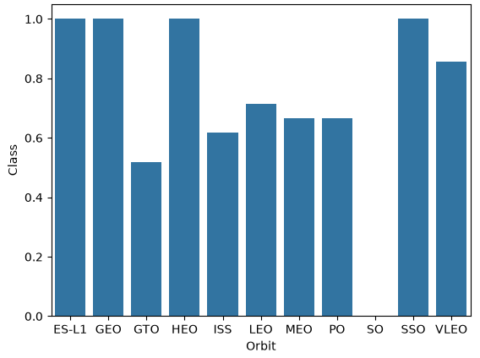
Success Rate vs Orbit Type
The bar chart of Success Rate vs Orbit Type shows that:
ES-L1, GEO, HEO, and SSO have the highest success rates at 100%
SO has the lowest success rate at 0%
VLEO has a high success rate of approximately 85%, while LEO has around 71%
MEO and PO have similar success rates of approximately 67%, indicating moderate landing performance

Slide 23
Success Rate vs Orbit Type
5. GTO and ISS have lower success rates compared with other orbit types, with GTO having approximately 50% success Overall, landing success varies across orbit types, suggesting that orbit type may be an important factor in predicting Falcon 9 landing outcomes.

Slide 24
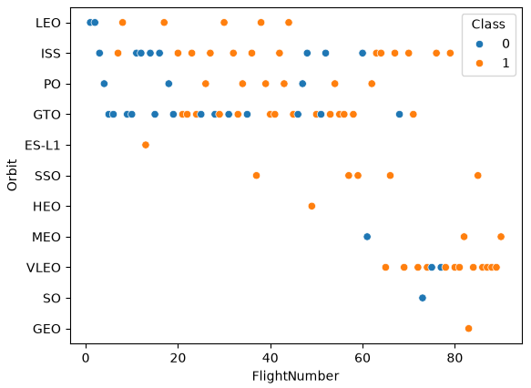
Flight Number vs Orbit Type
The scatter plot of Flight Number vs Orbit Type shows that:
Higher flight numbers have more successful landings outcomes across several orbit types
GTO and ISS have both successful and unsuccessful landing outcomes across different flight numbers
VLEO launches mainly occur at higher flight numbers and have mostly successful landing outcomes
LEO and PO have a wide range of flight numbers with both successful and unsuccessful landing outcomes observed

Slide 25
Flight Number vs Orbit Type
5. Some orbit types, such as GEO and ES-L1, have limited flight observations, making it difficult to identify a clear trend

Slide 26
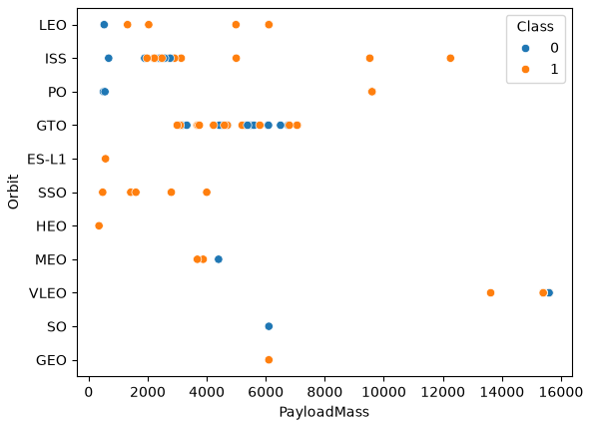
Payload Mass vs Orbit Type
The scatter plot of Payload Mass vs Orbit Type shows that:
VLEO launches mainly occur at higher payload masses and have mostly successful landing outcomes
GTO has the largest number of launches across a wide range of payload masses
LEO and ISS have successful and unsuccessful landing outcomes across different payload ranges

Slide 27
Payload Mass vs Orbit Type
4. Some orbit types, such as GEO and ES-L1, have limited payload observations, making it difficult to identify a clear trend
Overall, payload mass distribution varies across orbit types, but payload mass alone does not show a clear relationship with landing outcomes.

Slide 28
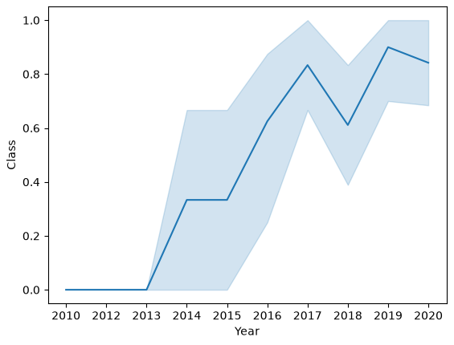
Launch Success Yearly Trend
The line chart of average Launch Success Yearly Trend shows that:
Landing success rate increases after 2013 The success rate remains at 0 before 2013, then rises in later years, indicating improved landing performance over time.
Later years achieve higher success rates Most years after 2016 show success rates above 50%, with the highest values occurring around 2017 and 2019.
Yearly success rates fluctuate across different years The success rate decreases in 2018 before increasing again in 2019, indicating variation in yearly landing outcomes.

Slide 29
Results
01
EDA with SQL

Slide 30
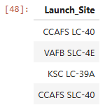
All Launch Site Names
Find the names of the launch sites.
SQL Query:
SQL Query Result:
SQL Explanation:
Using DISTINCT returns only unique values from the LAUNCH_SITE column of
the SPACEXTABLE table. The query returns the different launch locations used in the SpaceX launch dataset.

Slide 31
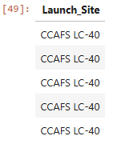
Launch Site Names Begin with 'CCA'
Find 5 records where launch sites begin with `CCA`.
SQL Query:
SQL Query Result:
SQL Explanation:
Using LIKE 'CCA%' filters the LAUNCH_SITE column of the SPACEXTABLE table to identify launch sites beginning with ‘CCA’., and LIMIT 5 displays the first five matching records from the SpaceX launch dataset. The query returns the first five launch site records matching the specified pattern in the dataset.

Slide 32

Total Payload Mass
Calculate the total payload carried by boosters from NASA.
SQL Query:
SQL Query Result:
SQL Explanation:
Using SUM(PAYLOAD_MASS__KG_) calculates the total payload mass from the PAYLOAD_MASS__KG_ column of the SPACEXTABLE table for records WHERE the CUSTOMER is 'NASA (CRS)'.
The query returns the total payload mass carried by boosters launched for NASA (CRS) missions in the SpaceX launch dataset.

Slide 33

Average Payload Mass by F9 v1.1
Calculate the average payload mass carried by booster version F9 v1.1.
SQL Query:
SQL Query Result:
SQL Explanation:
Using AVG(PAYLOAD_MASS__KG_) calculates the average payload mass from the PAYLOAD_MASS__KG_ column of the SPACEXTABLE table for records WHERE the BOOSTER_VERSION is 'F9 v1.1'.
The query returns the average payload mass carried by the F9 v1.1 booster version in the SpaceX launch dataset.

Slide 34

First Successful Ground Landing Date
Find the dates of the first successful landing outcome on ground pad.
SQL Query:
SQL Query Result:
SQL Explanation:
Using MIN(DATE) returns the earliest date from the DATE column of
the SPACEXTABLE table for records WHERE the Landing_Outcome is 'Success (ground pad)'.
The query returns the first successful ground pad landing date in the
SpaceX launch dataset.

Slide 35
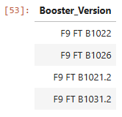
Successful Drone Ship Landing with Payload between 4000 and 6000
List the names of boosters which have successfully landed on drone ship and had payload mass greater than 4000 but less than 6000.
SQL Query:
SQL Query Result:
SQL Explanation:
Using the Landing_Outcome and PAYLOAD_MASS__KG_ columns from the SPACEXTABLE table identifies records WHERE the Landing_Outcome is 'Success (drone ship)' and the PAYLOAD_MASS__KG_ is greater than 4000 and less than 6000.
The query returns the booster versions that successfully landed on a drone ship with payload masses within the specified range in the SpaceX launch dataset.

Slide 36
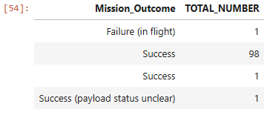
Total Number of Successful and Failure
Mission Outcomes
Calculate the total number of successful and failure mission outcomes.
SQL Query:
SQL Query Result:
SQL Explanation:
Using COUNT(MISSION_OUTCOME) calculates the total number of records for each MISSION_OUTCOME category from the SPACEXTABLE table.
The query returns the total number of successful and failure mission outcomes in the SpaceX launch dataset.

Slide 37
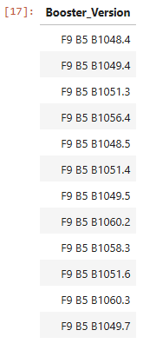
Boosters Carried Maximum Payload
List the names of the booster which have carried the maximum payload mass.
SQL Query:
SQL Query Result:
SQL Explanation:
Using DISTINCT(BOOSTER_VERSION) returns only unique booster version values from the BOOSTER_VERSION column of the SPACEXTABLE table WHERE PAYLOAD_MASS__KG_ equals the maximum payload mass calculated by MAX(PAYLOAD_MASS__KG_).
The query returns the booster versions that carried the maximum payload mass in the SpaceX launch dataset.

Slide 38
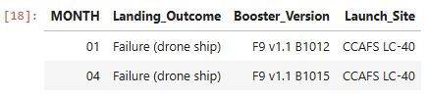
2015 Launch Records
List the failed landing_outcomes in drone ship, their booster versions, and launch site names in 2015.
SQL Query:
SQL Query Result:
SQL Explanation:
Using substr(Date, 6, 2) returns the month from the Date column of the SPACEXTABLE table for records WHERE substr(Date, 0, 5) is '2015' and Landing_Outcome is 'Failure (drone ship)'.
The query returns the month, landing outcome, booster version, and launch site for failed drone ship landing records in 2015 from the SpaceX launch dataset.

Slide 39
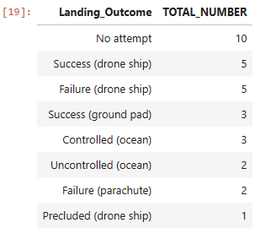
Rank Landing Outcomes Between 2010-06-04
and 2017-03-20
Rank the count of landing outcomes (such as Failure (drone ship) or Success (ground pad)) between the date 2010-06-04 and 2017-03-20, in descending order.
SQL Query:
SQL Query Result:
SQL Explanation:
Using COUNT(Landing_Outcome) calculates the total number of records for each Landing_Outcome category from the SPACEXTABLE table between '2010-06-04' and '2017-03-20', and ORDER BY TOTAL_NUMBER DESC ranks the counts in descending order.
The query returns the landing outcome counts ranked from highest to lowest for the specified date range in the SpaceX launch dataset.

Slide 40
Results
02
Launch Sites Proximity Analysis - Folium Interactive Map

Slide 41
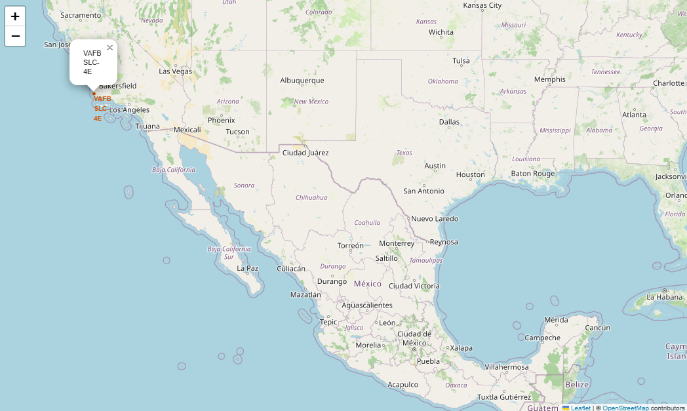
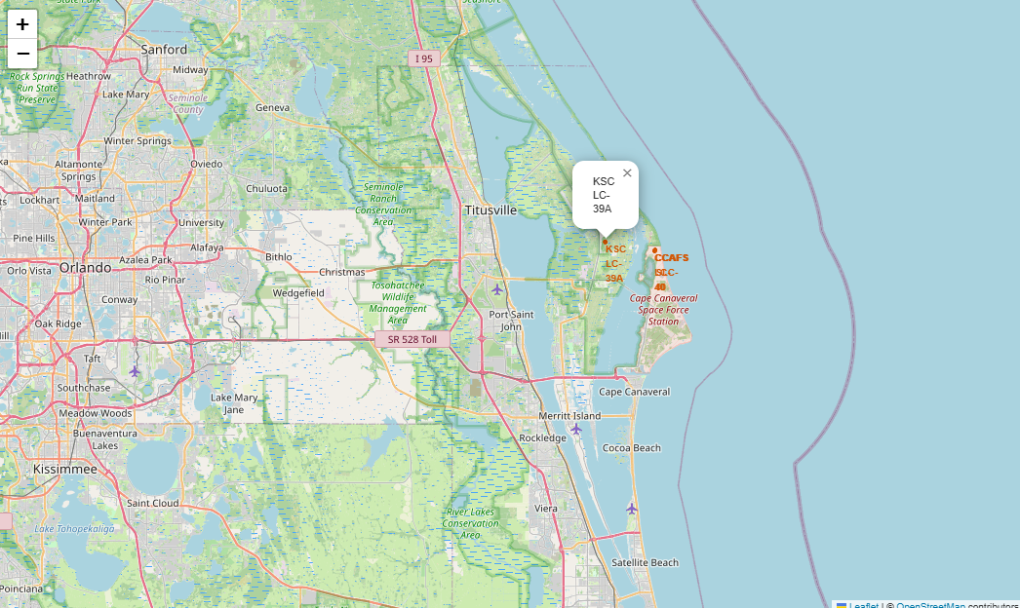
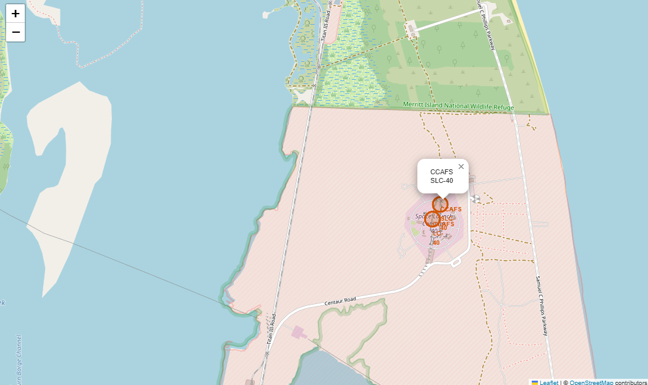
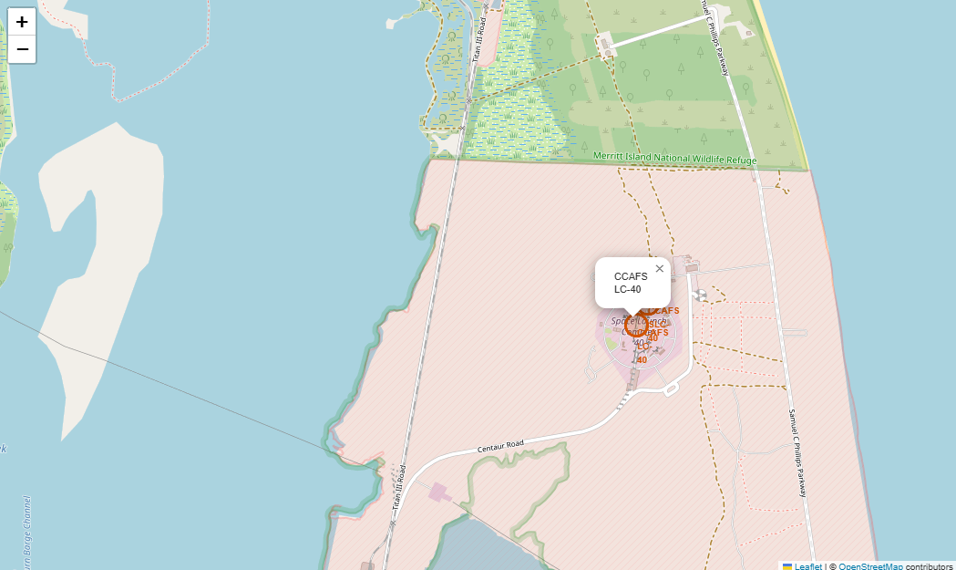
All Launch Sites On The Map
The map screenshots shows the locations of four SpaceX launch sites across the United States:
CCAFS LC-40, CCAFS SLC-40, and KSC LC-39A are located close to each other on Florida’s east coast, near Cape Canaveral and Kennedy Space Center. While VAFB SLC-4E is located separately on the west coast in California
All launch sites shown are near coastal areas, which is important for rocket launch safety and access to open ocean flight paths
VAFB SLC-4E (34.632834, -120.610745)
KSC LC-39A (28.573255, -80.646895)
CCAFS SLC-40 (28.563197, -80.576820)
CCAFS LC-40 (28.562302, -80.577356)
Notes:
The launch outcome map shows that launch success varies by site, with KSC LC-39A appearing more successful than the CCAFS launch sites in the displayed data.

Slide 42
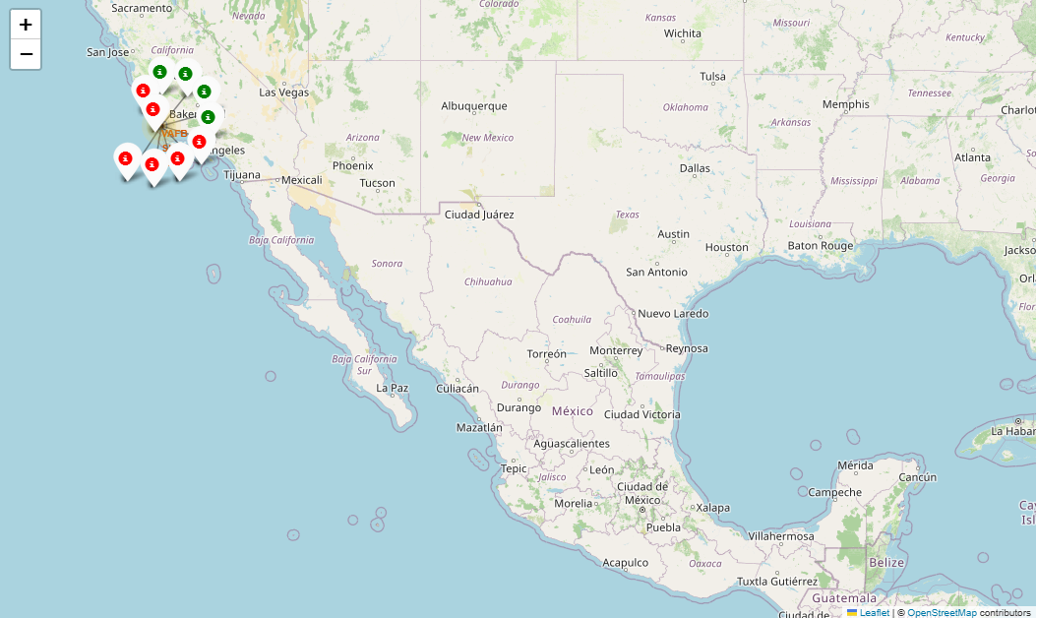
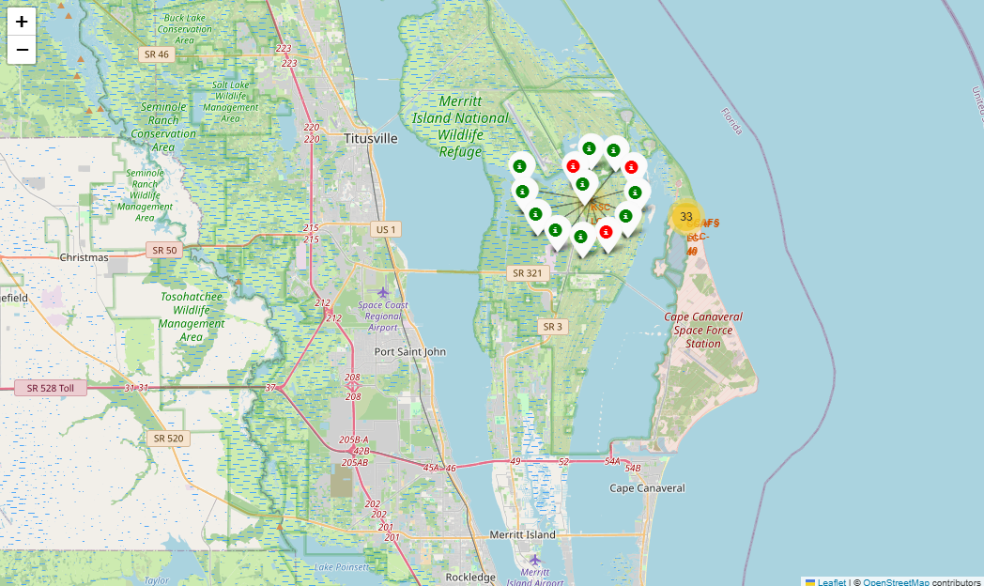
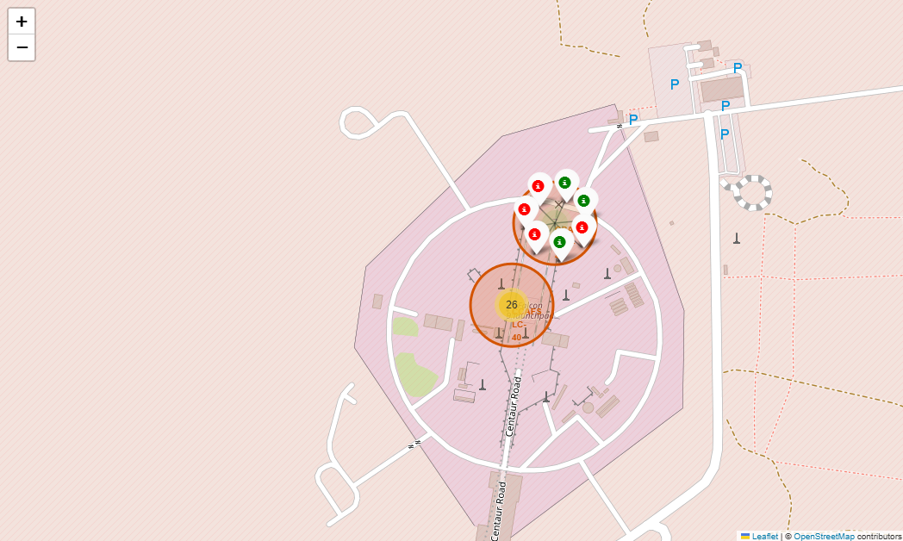
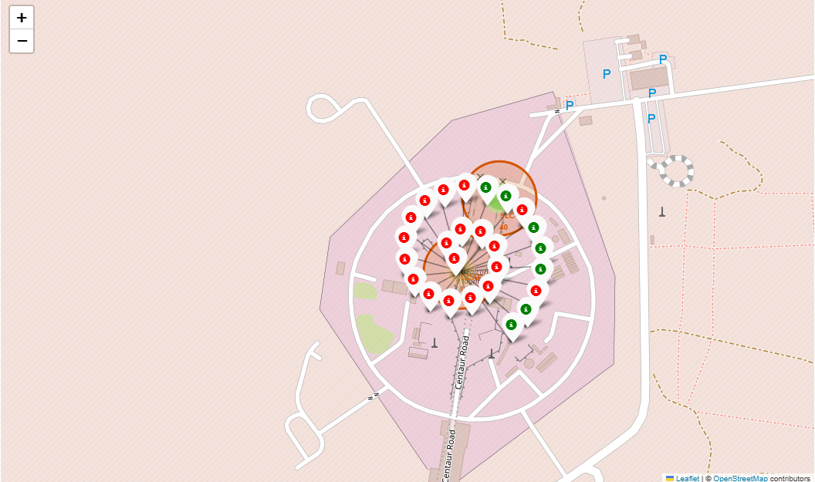
All Success / Failed Launches For
Each Site On The Map
The map screenshots shows successful and failed launches at four SpaceX launch sites using color-coded markers, green and red:
KSC LC-39A has more green markers, suggesting a relatively higher launch success rate
CCAFS LC-40 and CCAFS SLC-40 have more red markers, suggesting lower launch success rates
VAFB SLC-4E has both green and red markers, showing mixed launch outcomes
VAFB SLC-4E (34.632834, -120.610745)
KSC LC-39A (28.573255, -80.646895)
CCAFS SLC-40 (28.563197, -80.576820)
CCAFS LC-40 (28.562302, -80.577356)
Notes:
The color-coded Folium map makes it easy to compare launch outcomes by site. In the displayed map, KSC LC-39A appears to have stronger launch success performance, while CCAFS LC-40 and CCAFS SLC-40 show more failed launches. KSC LC-39A appears to perform better, while the CCAFS sites show more failed launches in the displayed data.

Slide 43
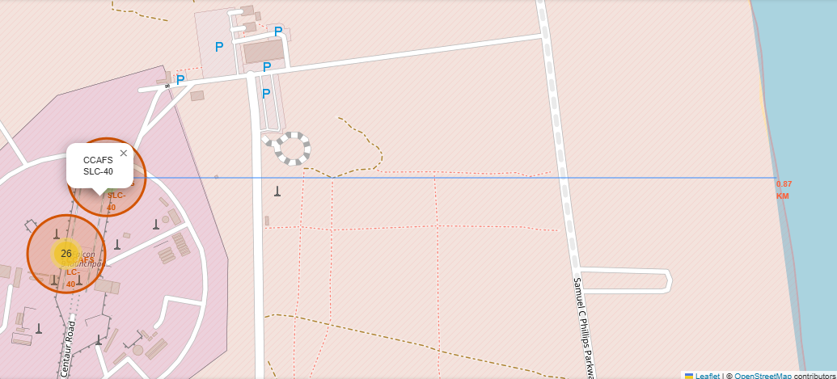
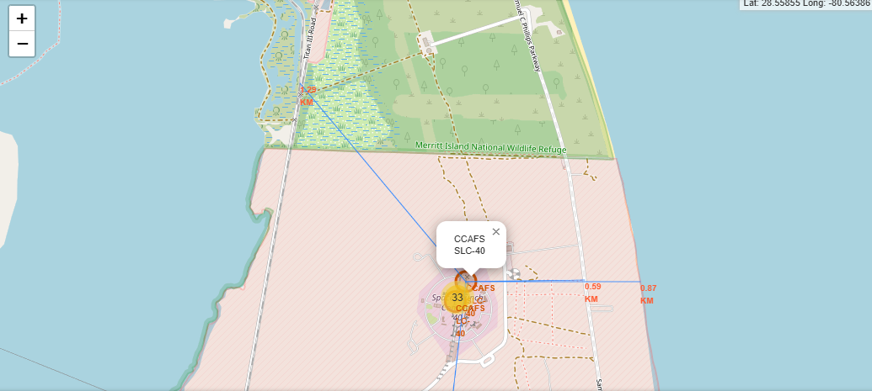
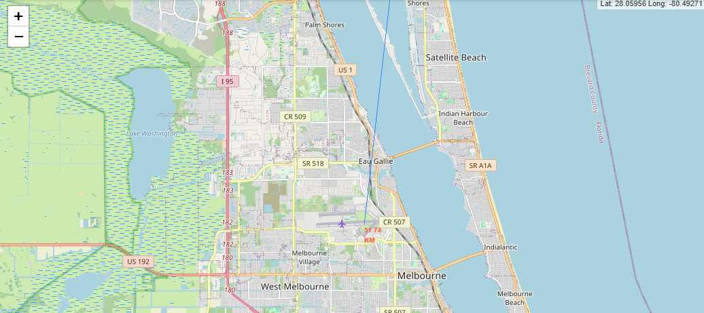
Proximity Of A Selected Launch Site
To Other Points of Interest
The map screenshots show the approximate distance from the CCAFS SLC-40 launch site to nearby points of interest using blue distance lines, including the coastline, highway, railway, and city locations:
The coastline is 0.87 km due east of the launch site
The nearest highway is 0.59 km away
The nearest railway is 1.29 km away
The nearest city is 51.74 km away

Slide 44
Results
02
interactive Dashboard - Plotly Dash

Slide 45
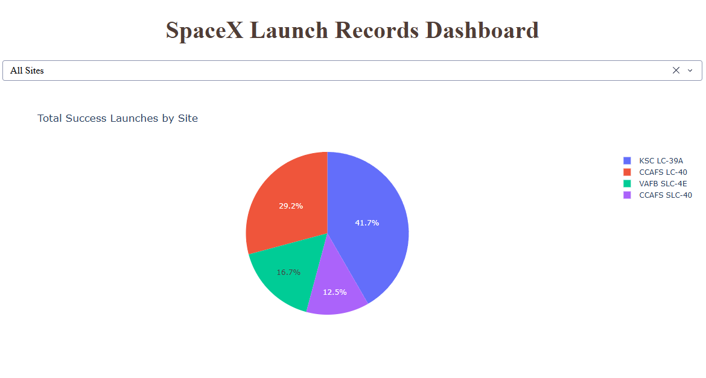
Total Success Launches For All Sites
The pie chart of Total Success Launches For All Sites shows that:
KSC LC-39A had the most successful launches, accounting for 41.7% of the total
CCAFS LC-40 had the second most successful launches, accounting for 29.2% of the total
VAFB SLC-4E accounted for 16.7% of the total successful launches
CCAFS SLC-40 had the fewest successful launches, accounting for 12.5% of the total
Overall, KSC LC-39A was the most successful launch site, accounting for 41.7% of total successful launches, while CCAFS SLC-40 had the lowest share among the four sites shown.

Slide 46
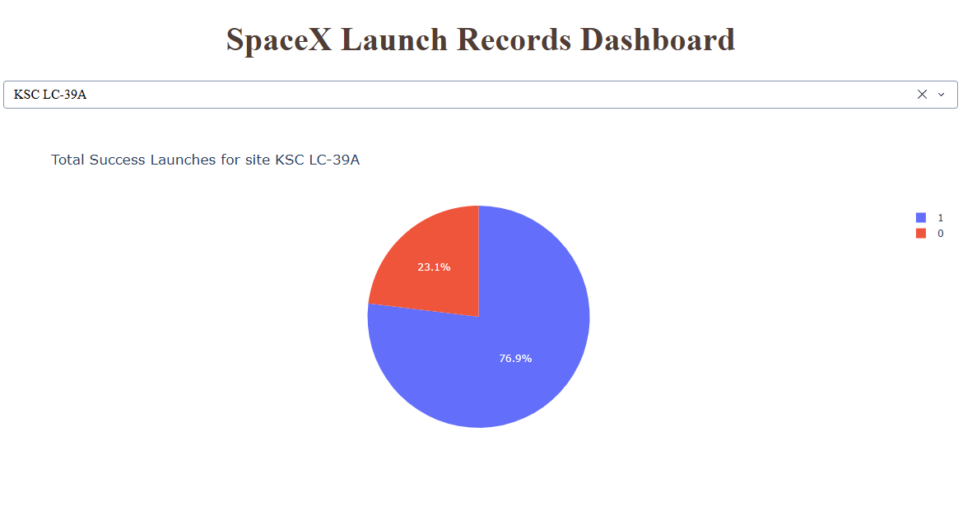
Launch Site With Highest Launch Success Ratio
The pie chart of Launch Site With Highest Launch Success Ratio shows that:
KSC LC-39A had the highest launch success ratio among all launch sites, with 76.9% successful launches and 23.1% unsuccessful launches.

Slide 47
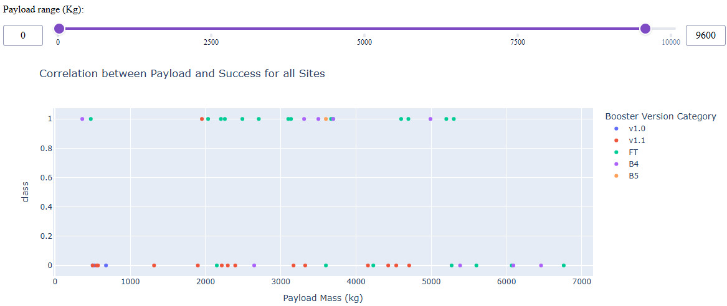
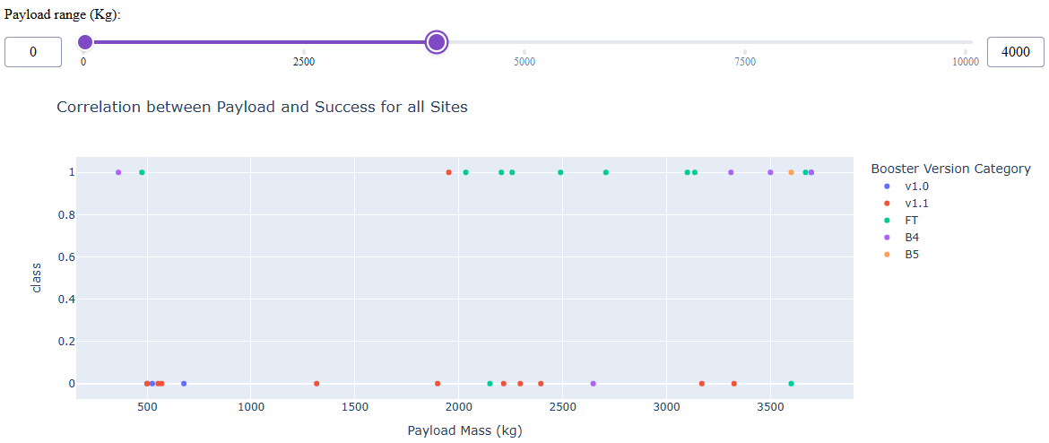
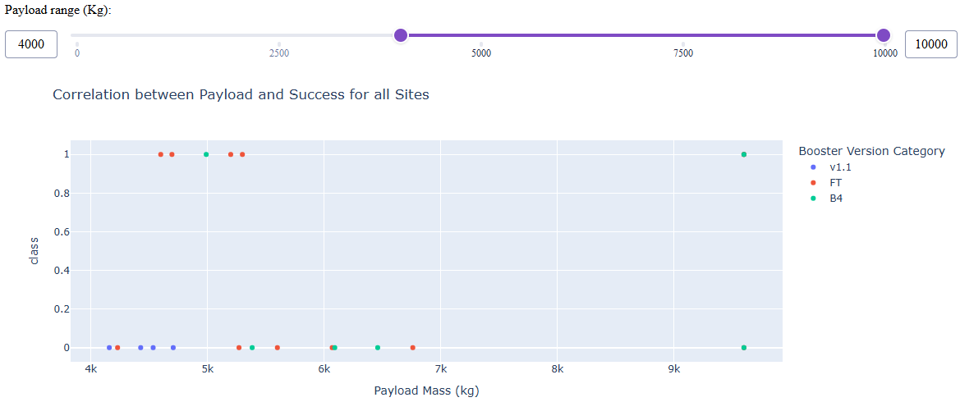
Payload Mass vs Launch Outcome For
All Sites
The scatter plots of Payload Mass vs Launch Outcome For All Sites, with different payload ranges selected using the range slider, show that:
The full payload range plot shows a visible gap around 4000 kg, so the data can be divided into two ranges: 0–4000 kg for low payloads and 4000–10000 kg for massive payloads
The 0–4000 kg range shows a higher launch success pattern than the massive payload range. In particular, the 3000–4000 kg range appears to have the largest success rate
Low payloads
Massive payloads

Slide 48
Payload Mass vs Launch Outcome For
All Sites
3. The 4000–10000 kg range has fewer successful launches, suggesting that massive payloads have a lower launch success rate than low payloads
4. The FT booster version appears to have the strongest launch success pattern among the booster types shown
5. Some booster types such as v1.0 and B5 have not been launched with massive payloads
Low payloads
Massive payloads

Slide 49
Results
03
Predictive Analysis - Classification

Slide 50
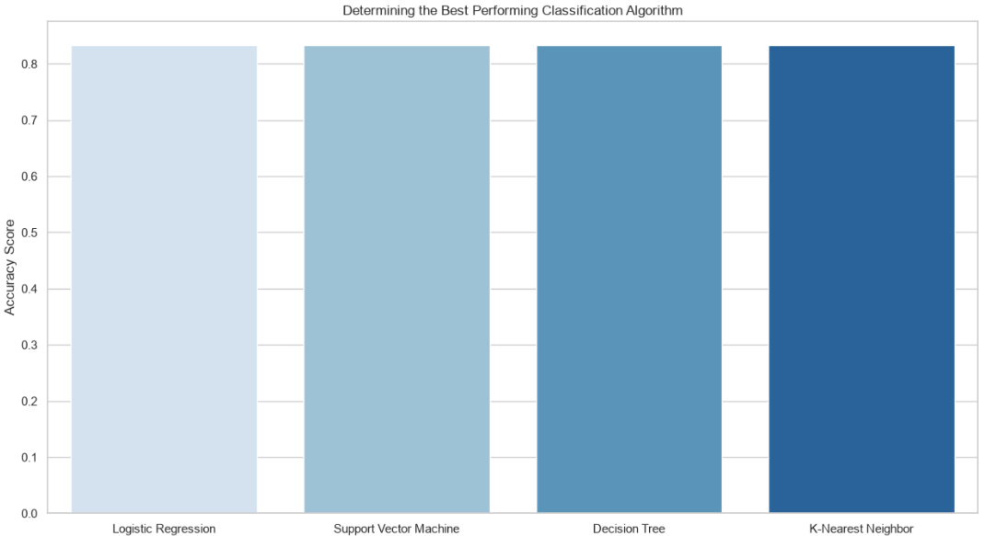
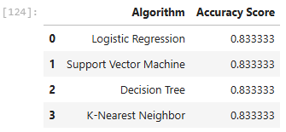
Classification Accuracy
The bar charts compare the Accuracy Score For All Classification Models and show that:
All Classification Models achieved the same Accuracy Score of 83.33%. Therefore, no single model outperforms the other.

Slide 51
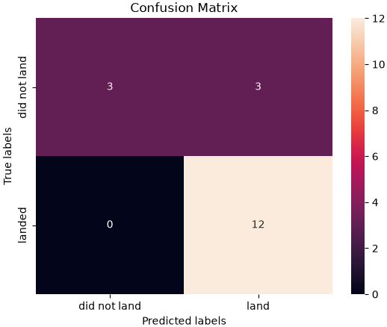

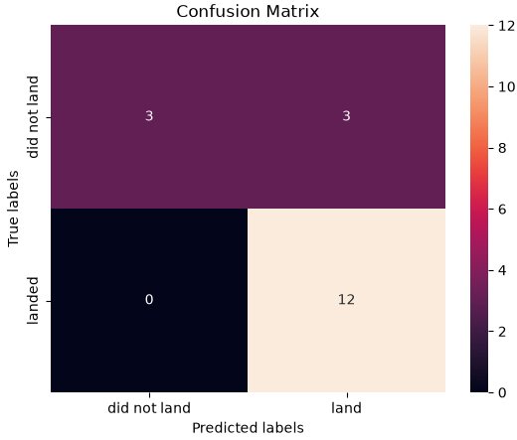

Confusion Matrix
As shown in the previous slide, all Classification Models achieved the same accuracy, so there is no single best-performing model. Their confusion matrices also produced the same results:
15 out of 18 test cases were classified correctly: 12 successful landings (True Positives) and 3 unsuccessful landings (True Negatives).
3 cases were misclassified as successful landings (False Positives), while no successful landings were incorrectly predicted as unsuccessful (False Negatives)
Logistic Regression
Support Vector Machine (SVM)
Decision Tree
K-Nearest Neighbor (KNN)

Slide 52
Conclusions
Falcon 9 landing performance improved over time: higher flight numbers and later years show more successful landings, with success increasing after 2013 and most years after 2016 above 50%.
Orbit type appears to be an important factor in landing outcomes. ES-L1, GEO, HEO, and SSO show the highest success rates at 100%, while SO shows the lowest success rate at 0%.
Launch site performance differs across sites. KSC LC-39A had the largest share of successful launches, accounting for 41.7% of total successful launches, and also had the highest success ratio at 76.9%.

Slide 53
Conclusions
Payload mass alone does not show a clear relationship with landing outcomes. However, dashboard results suggest that low payloads, especially the 3000–4000 kg range, show a stronger success pattern than massive payloads.
All four classification models: Logistic Regression, Support Vector Machine (SVM), Decision Tree, and K-Nearest Neighbor (KNN) achieved the same accuracy score of 83.33%, so no single model outperformed the others.

Slide 54
Appendix
Slide 7 Data Collection - SpaceX REST API Flowchart
Slide 8 Data Collection - Web Scraping Flowchart
Slide 9 Data Wrangling Flowchart
Slide 15 Predictive Analysis - Classification Flowchart
This Capstone’s GitHub Repository

Slide 55
Thank You!

